Slide 1

ANALYSIS OF SALES PREDICTION DATASET
Submitted By:
Sharon Blessy J V
Indian Institute Of Information Technology Tiruchirappalli

Slide 2

Contents of the Dataset:
The dataset contains information about advertising expenditures of a company on various platforms (TV, Radio, newspapers) and the corresponding sales of a product.
Size of the Dataset:
The dataset contains 200 rows and 5 columns.
Missing Data in the Dataset:
The dataset contains two missing data values under the ‘Radio’ column.

Slide 3



Average advertising amount on TV, Radio and Newspaper:
Total amount on TV, Radio and Newspaper advertising:

Slide 4
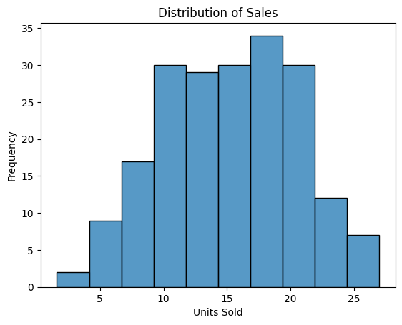
Distribution Range of the Sales:

Slide 5
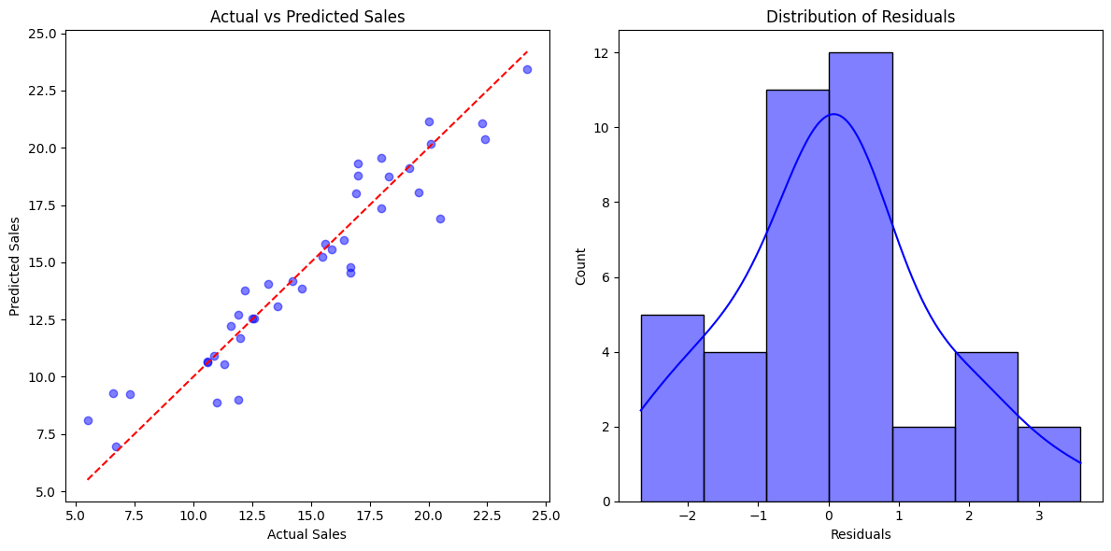
Linear Regression Line:

